Slide 1
Ggplot2 and interactive graphics with R
Christophe Ladroue
SECTION 01
Getting started with ggplot2
www.PacktPub.com

Slide 2
In this section we’re going to take a look at
Setting up ggplot2 and RStudio
Understanding the structure of a plot
Mapping the data to graphical elements with aesthetics
Understanding some subtleties with aesthetics
Using ggplot2 in scripts

Slide 3
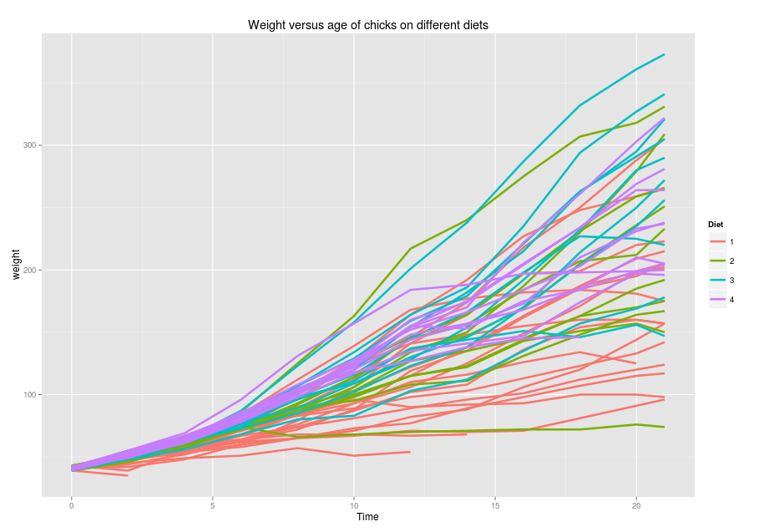
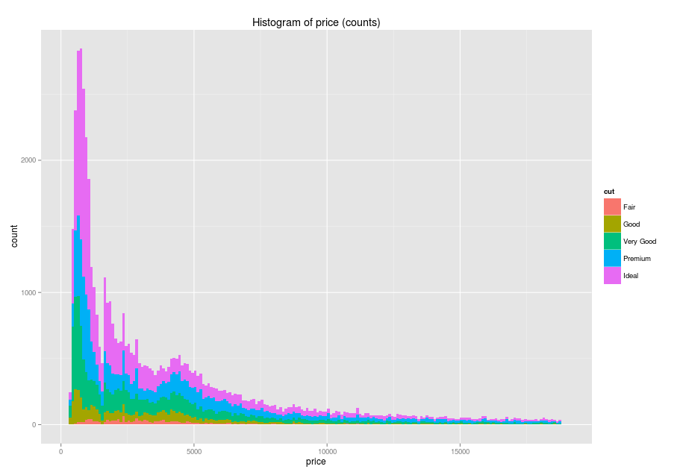
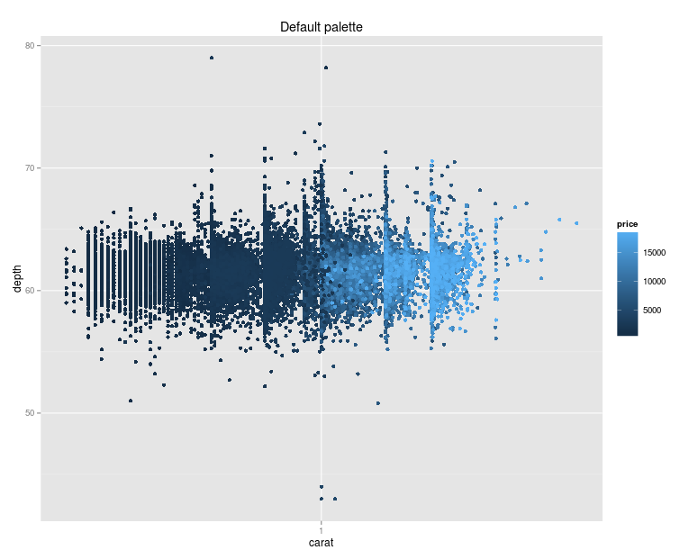
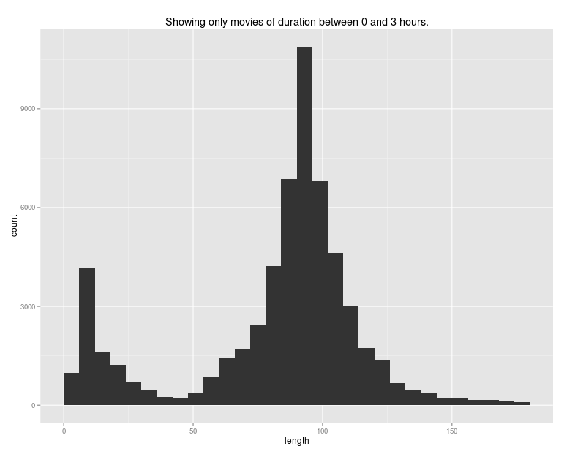
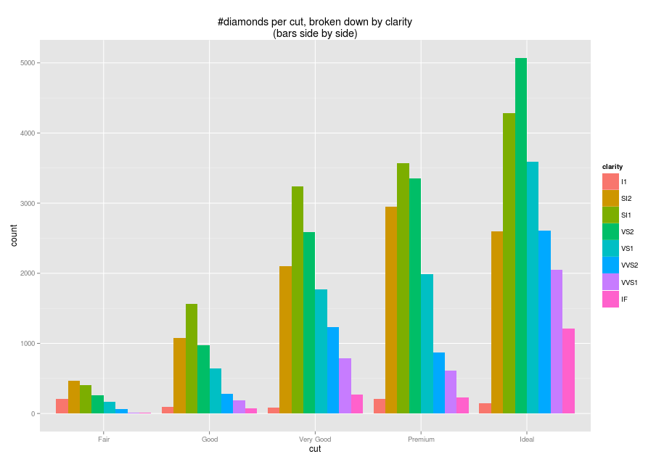
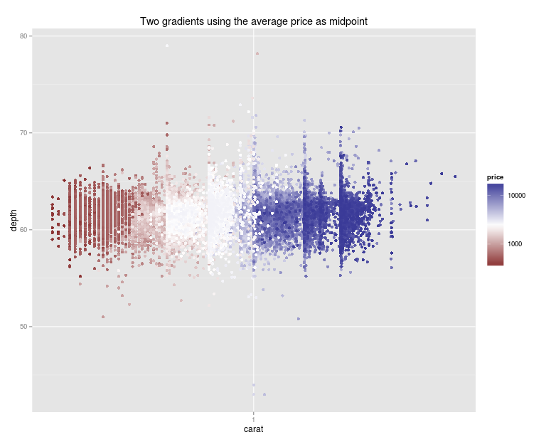
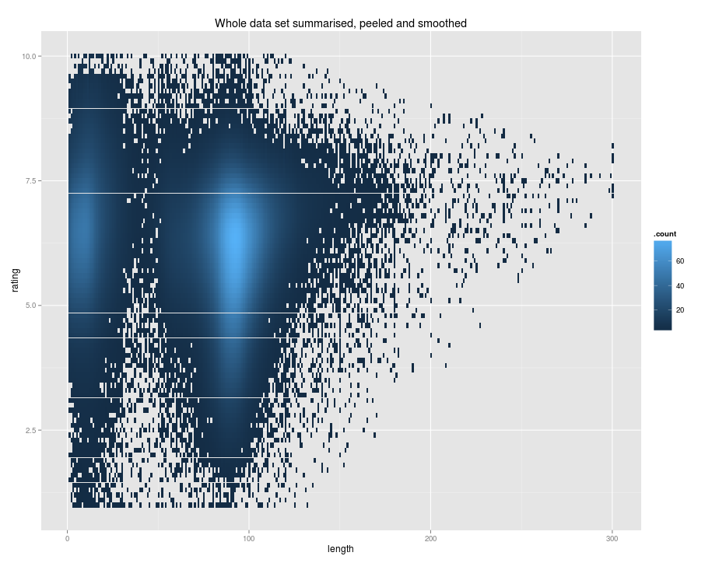
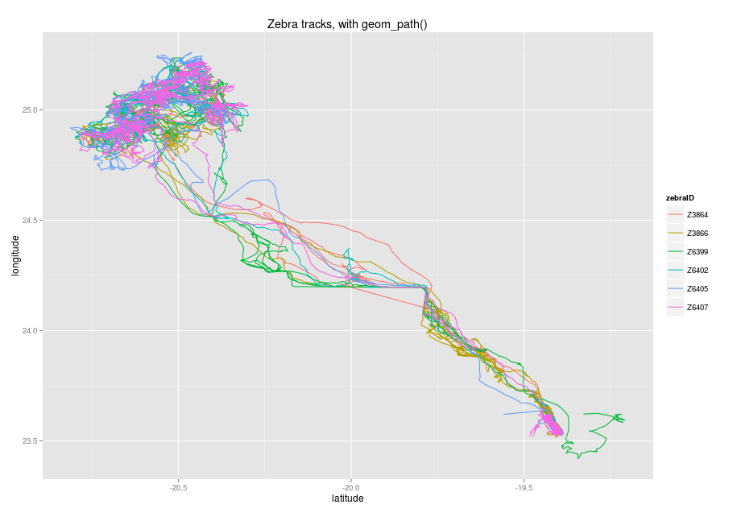

Slide 4
In this video we took a look at
Installing the free editor Rstudio
Installing the ggplot2 package
Next: the structure of a ggplot command

